Slide 1
Medical Image Processing Applications
by Niranjan U C Adjunct Professor, MIT, Manipal
ucniranjan@gmail.com

Slide 2
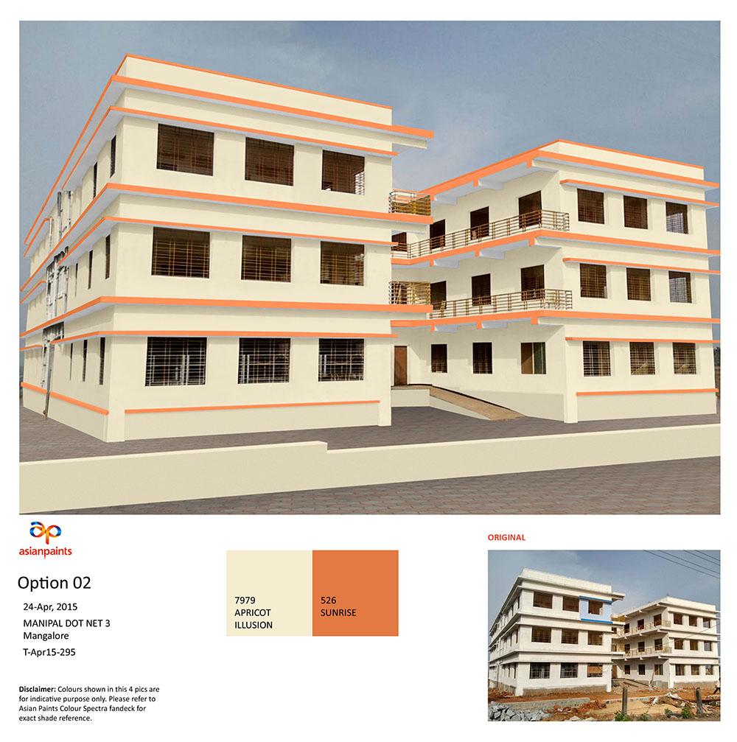

Slide 3
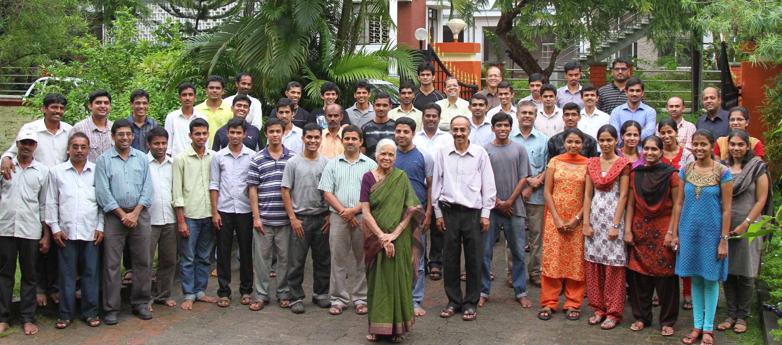

Slide 4
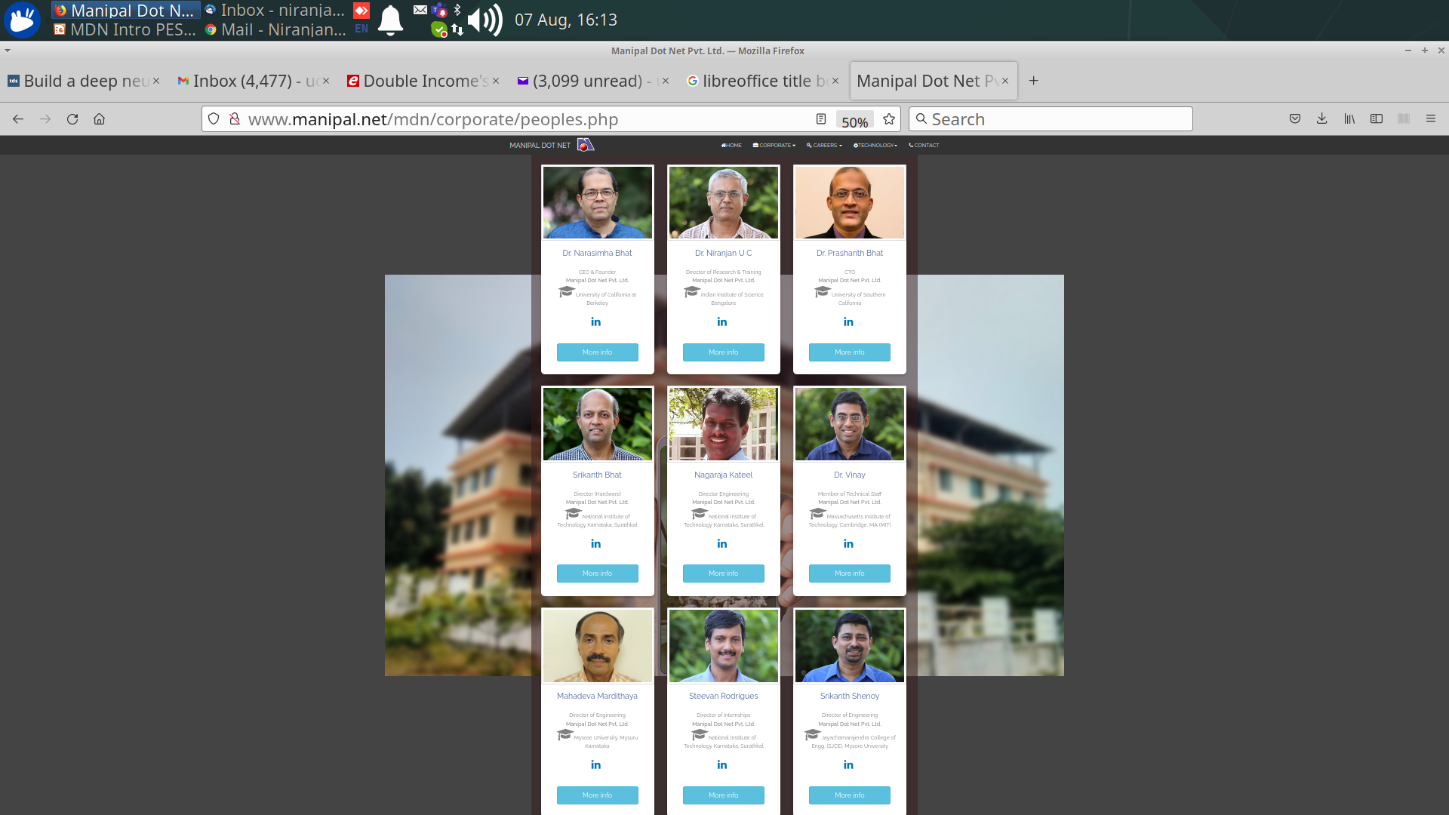
Team
Notes:
<number>

Slide 5
Agenda
MedTech
Processing
Applications

Slide 6
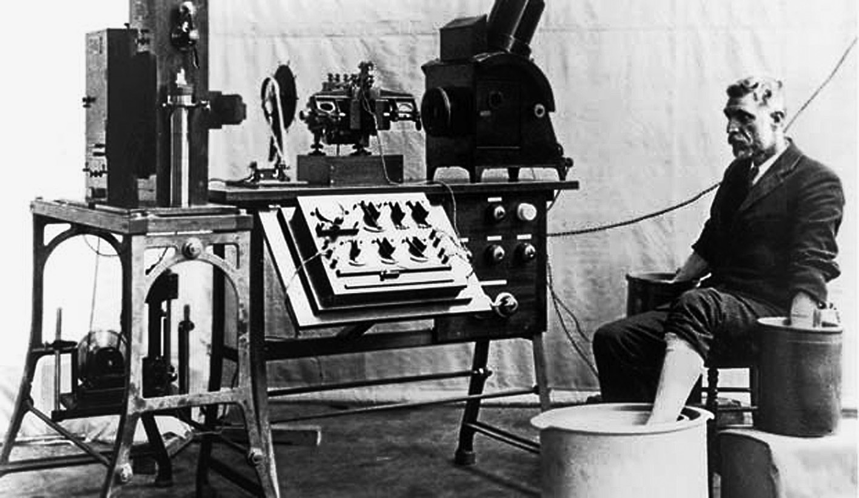
Tech History

Slide 7
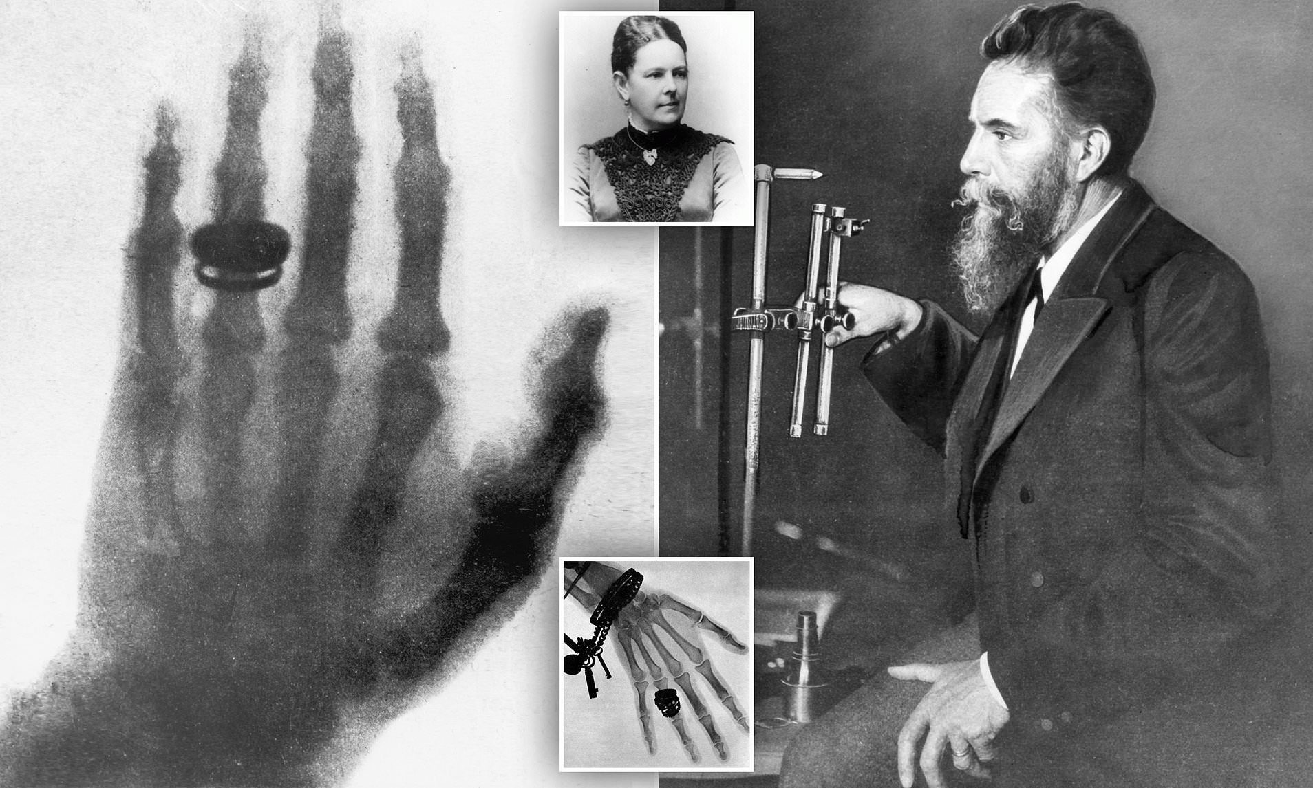

Slide 8
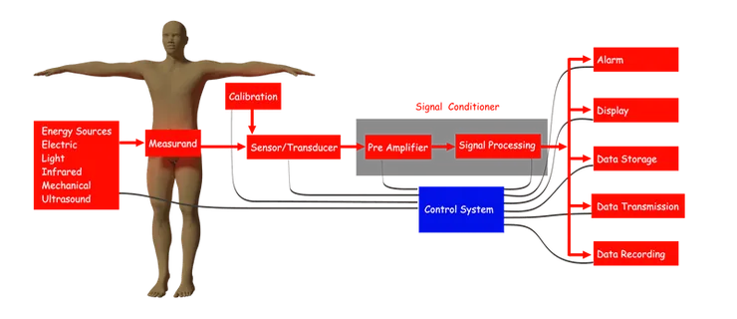
Biomedical Instrumentation

Slide 9
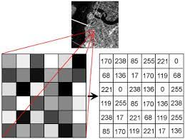
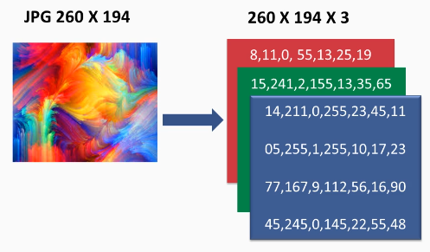
Image Representation

Slide 10
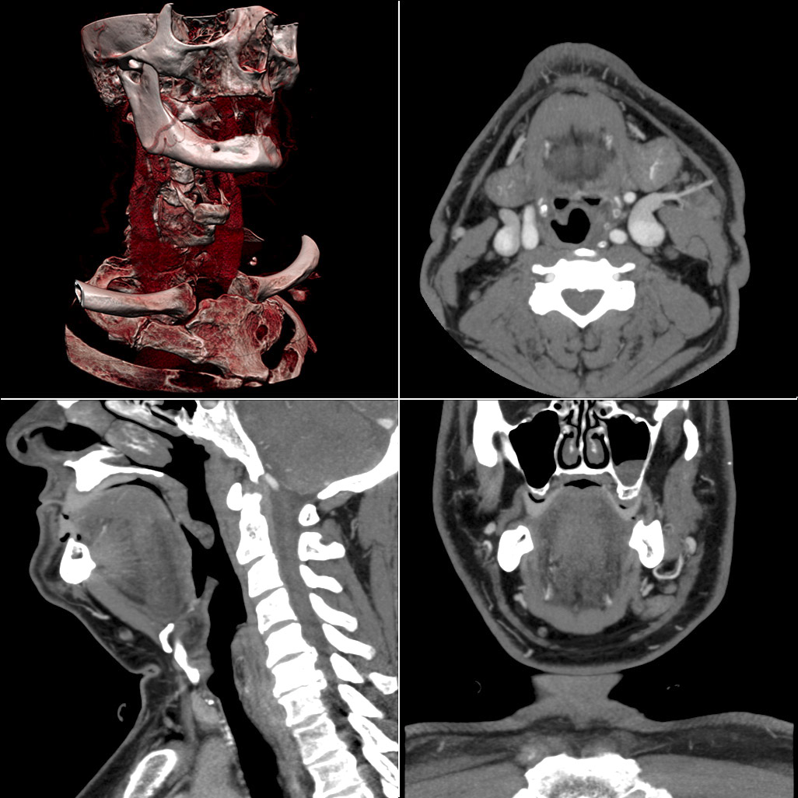
Notes:
<number>

Slide 11
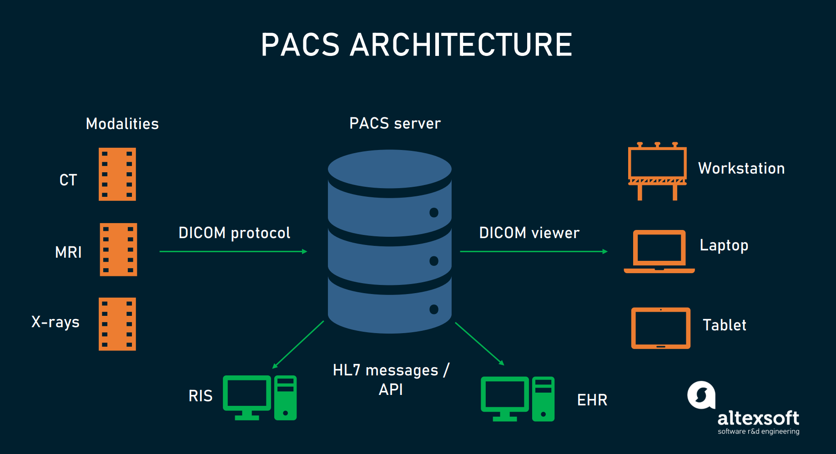

Slide 12
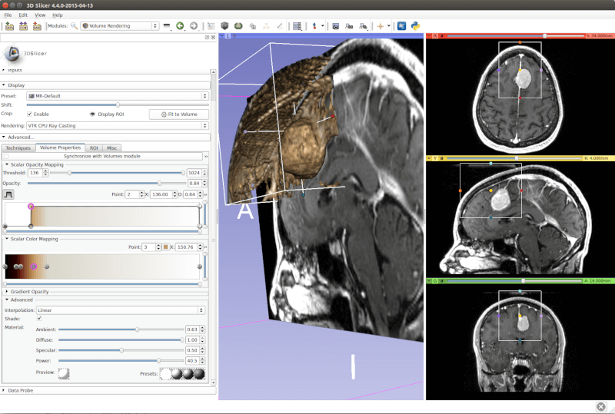
3D Slicer

Slide 13
Image Processing

Slide 14
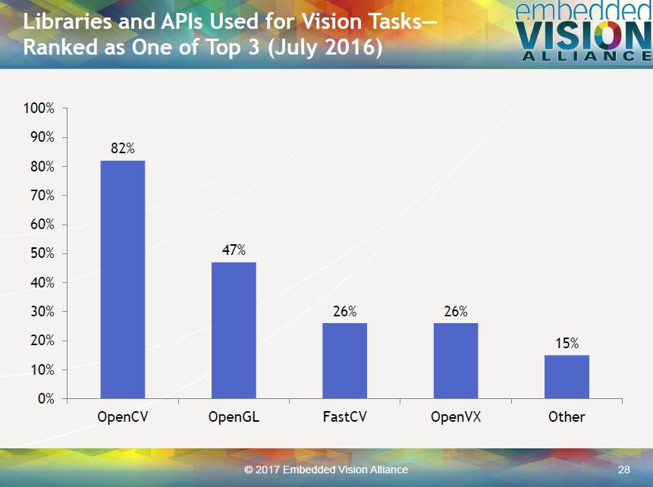
Notes:
<number>
<number>

Slide 15
Pseudo Code
face_cascade = cv2.CascadeClassifier('haarcascade_frontalface_default.xml')
img = cv2.imread('sachin.jpg')
gray = cv2.cvtColor(img, cv2.COLOR_BGR2GRAY)
faces = face_cascade.detectMultiScale(gray, 1.3, 5)
for (x,y,w,h) in faces:
cv2.rectangle(img,(x,y),(x+w,y+h),(255,0,0),2)
cv2.imshow('img',img)
cv2.waitKey(0)
cv2.destroyAllWindows()
Notes:
<number>
<number>
<number>
<number>

Slide 16
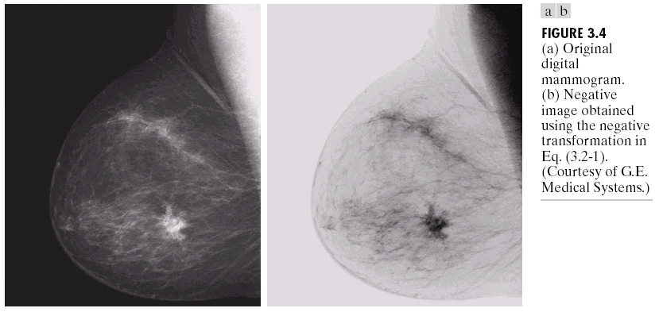
Image Negative
L-1
Original
digital
mammogram
White
Output intensity
Negative
digital
mammogram
Black
0
L-1
Black
Input intensity
White
L = the number of gray levels
(Images from Rafael C. Gonzalez and Richard E.
Wood, Digital Image Processing, 2nd Edition.

Slide 17
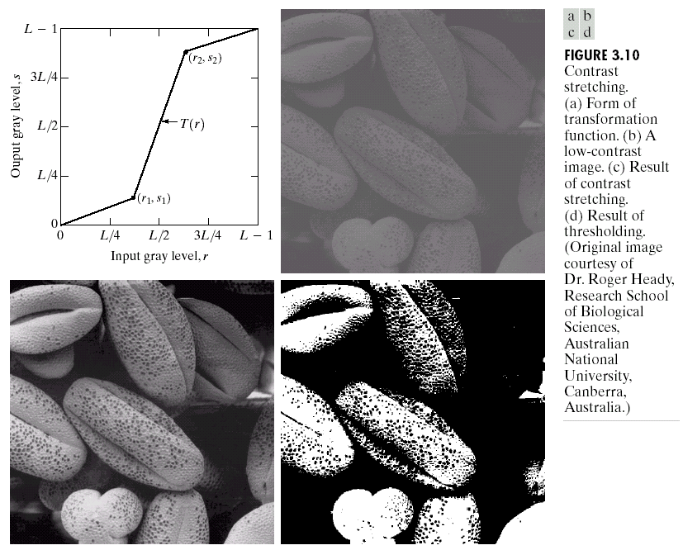
Contrast Stretching
Contrast means the difference
between the brightest and darkest
intensities
Before contrast
enhancement
After
(Images from Rafael C. Gonzalez and Richard E.
Wood, Digital Image Processing, 2nd Edition.

Slide 18
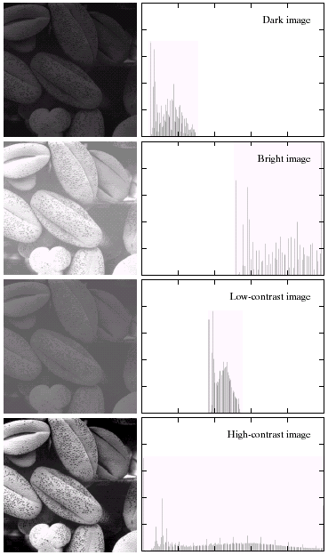
Histogram of an Image
= graph of no. of pixels vs intensities
Dark image has
histogram on the left
จำนวน pixel
Bright image has
histogram on the right
จำนวน pixel
(Images from Rafael C. Gonzalez and Richard E.
Wood, Digital Image Processing, 2nd Edition.

Slide 19
Histogram of an Image (cont.)
low contrast image
has narrow histogram
high contrast image
has wide histogram
(Images from Rafael C. Gonzalez and Richard E.
Wood, Digital Image Processing, 2nd Edition.

Slide 20
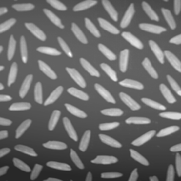
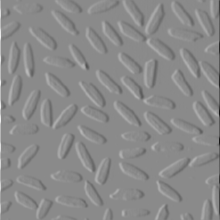
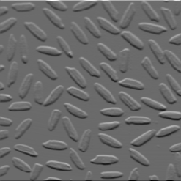
First Order Partial Derivative:
Sobel operators
-1
0
1
-1
-2
-1
$\text{to compute }\frac{∂P}{∂x}$
$\text{to compute }\frac{∂P}{∂y}$
-2
0
2
0
0
0
-1
0
1
1
2
1
P
$\frac{∂P}{∂x}$
$\frac{∂P}{∂y}$

Slide 21
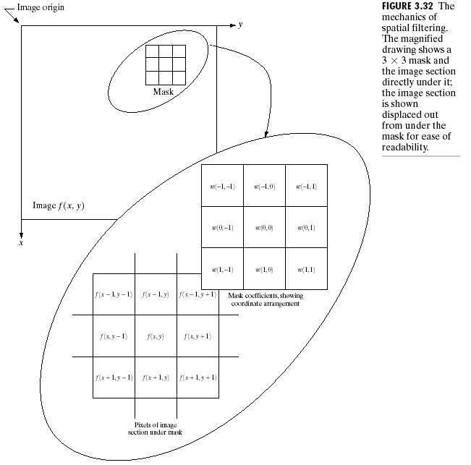
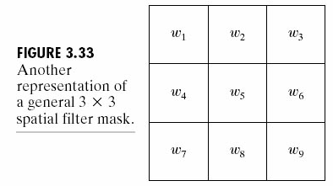
Basics of Spatial Filtering

Slide 22
Smoothing Spatial Filters
The general implementation for filtering an MXN image with a weighted averaging filter of size mxn is given by
where a=(m-1)/2 and b=(n-1)/2
$g\left(x,y\right)=\frac{\sum_{s=−a}^{a}{\sum_{t=−b}^{b}{w\left(s,t\right)f\left(x+s,y+t\right)}}}{\sum_{s=−a}^{a}{\sum_{t=−b}^{b}{w\left(s,t\right)}}}$

Slide 23
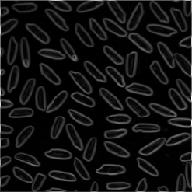
First Order Partial Derivative: Image Gradient
$\frac{∂P}{∂y}$
P
$\frac{∂P}{∂x}$
$\left|∇P\right|$

Slide 24
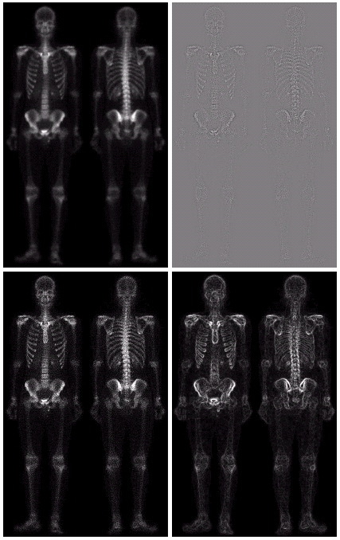
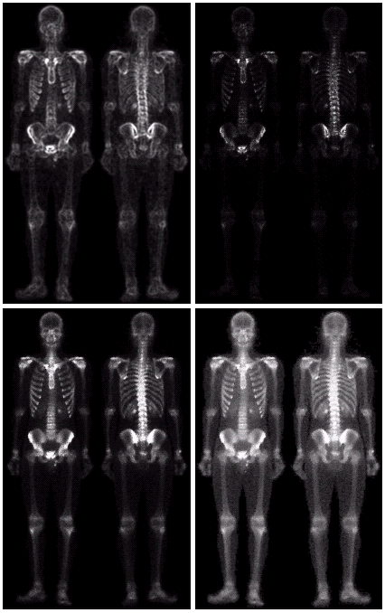

Slide 25
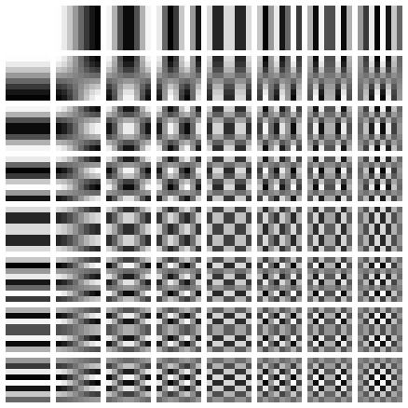
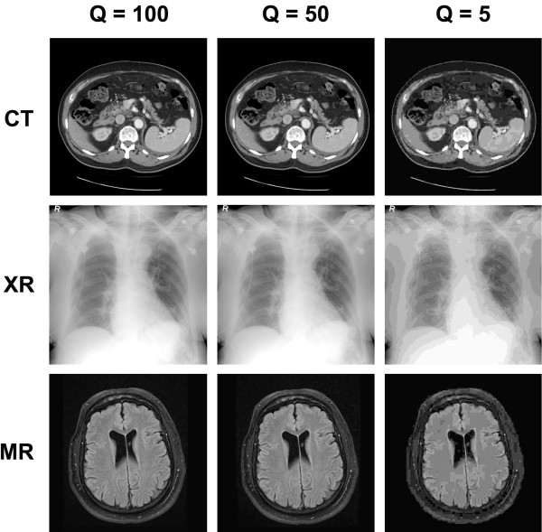
DCT, JPEG

Slide 26
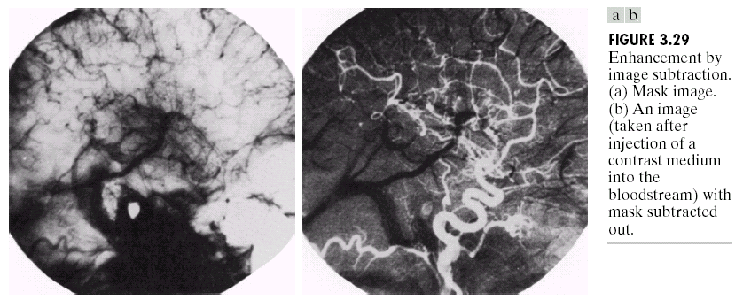
Arithmetic Operation: Subtraction (cont.)
Application: Mask mode radiography in angiography work
(Images from Rafael C. Gonzalez and Richard E.
Wood, Digital Image Processing, 2nd Edition.

Slide 27
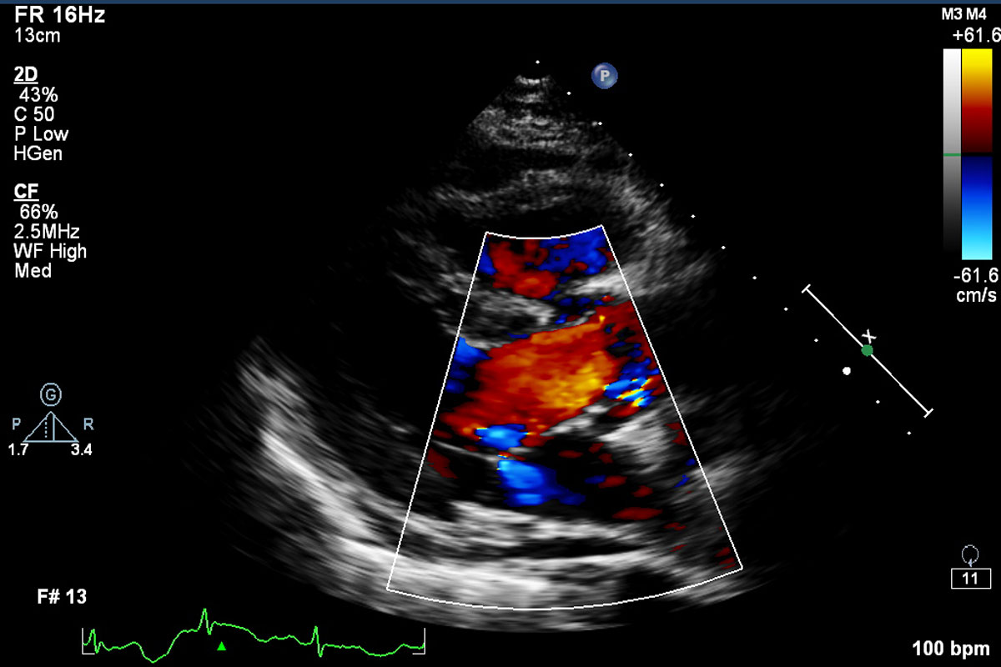
Pseudo Coloring

Slide 28
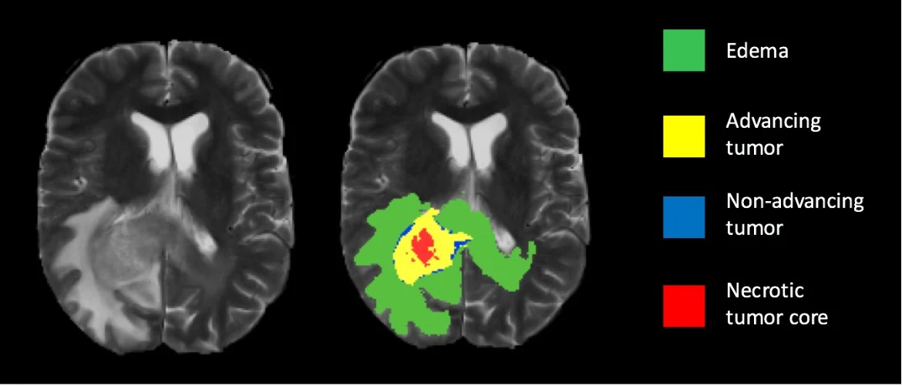
Image Segmentation

Slide 29
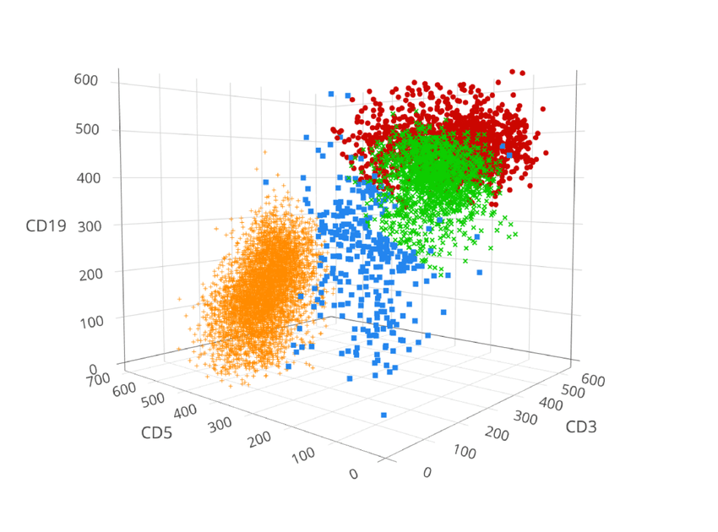

Slide 30
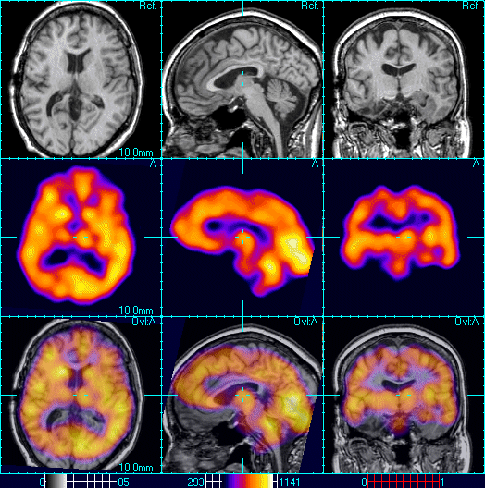
Image Registration
Notes:
<number>

Slide 31
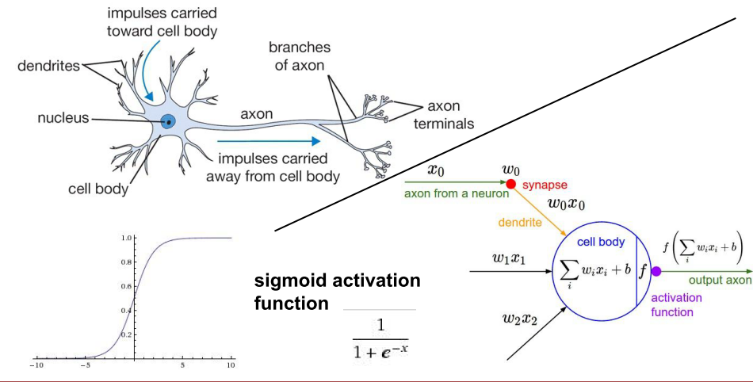
Biological Neural Network, ANN

Slide 32
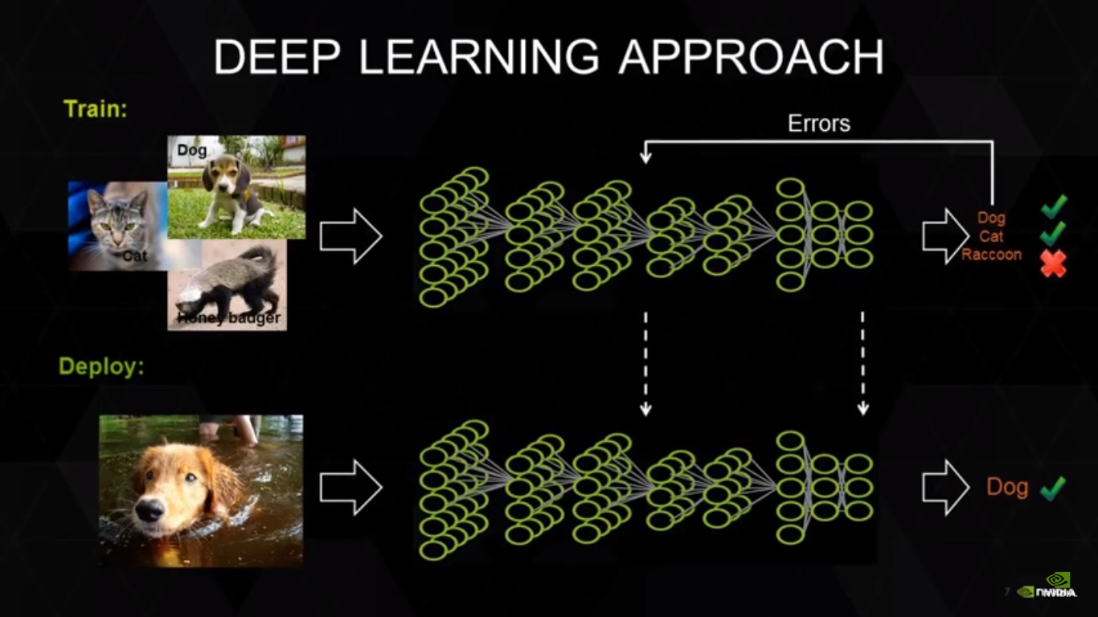
Notes:
<number>

Slide 33
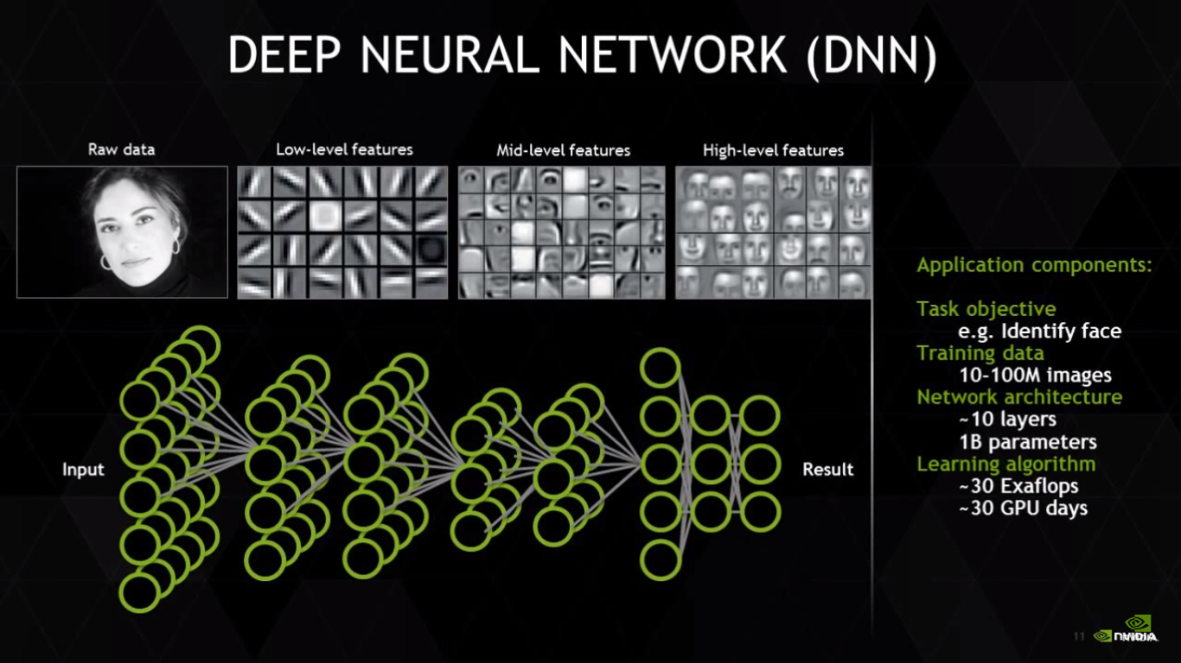
Notes:
<number>

Slide 34
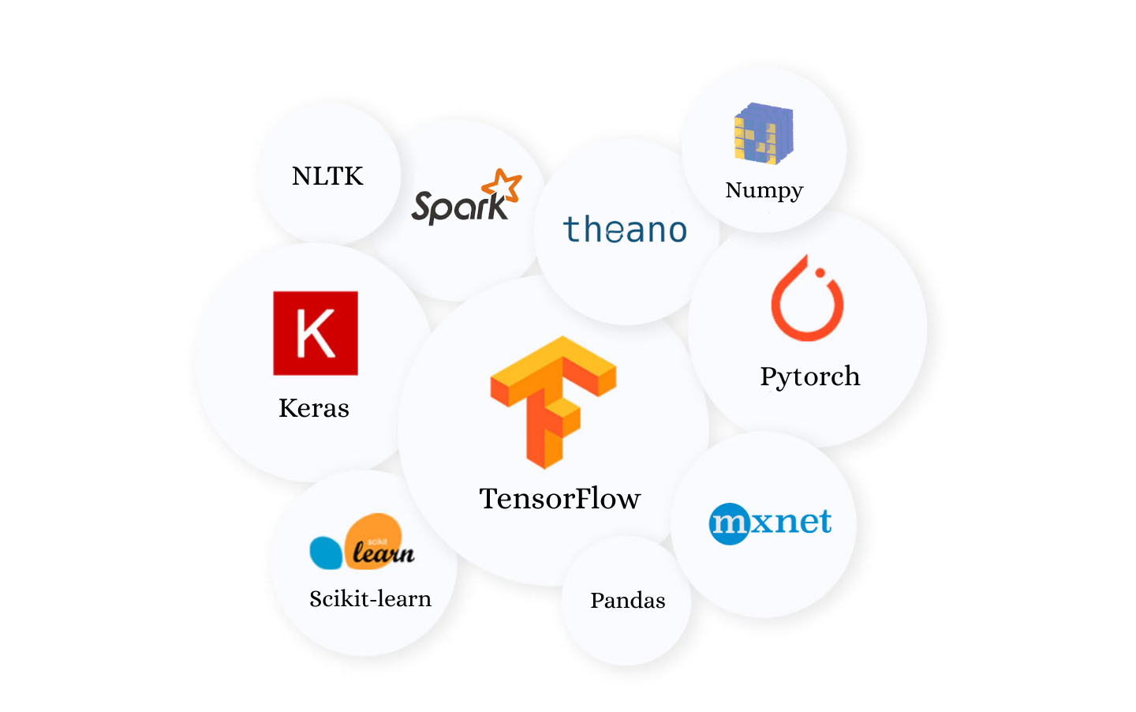
ML Libraries

Slide 35
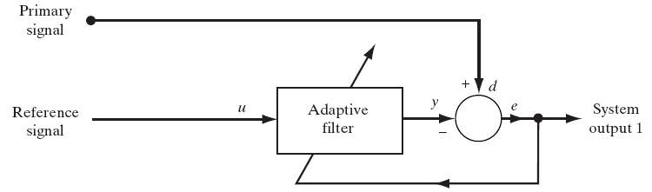
Adaptive Filtering Application
h(n+1) = h(n) + 2 * mu * output(n) * mother(n)
output(n) = abdomin(n) - h(n) * mother(n)

Slide 36
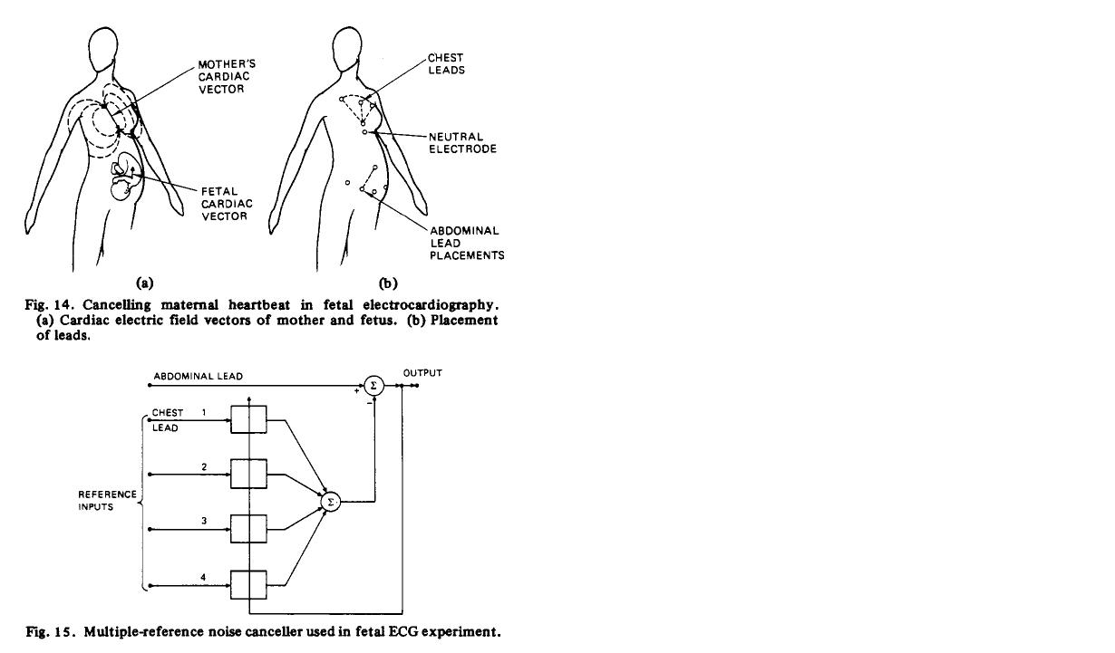

Slide 37
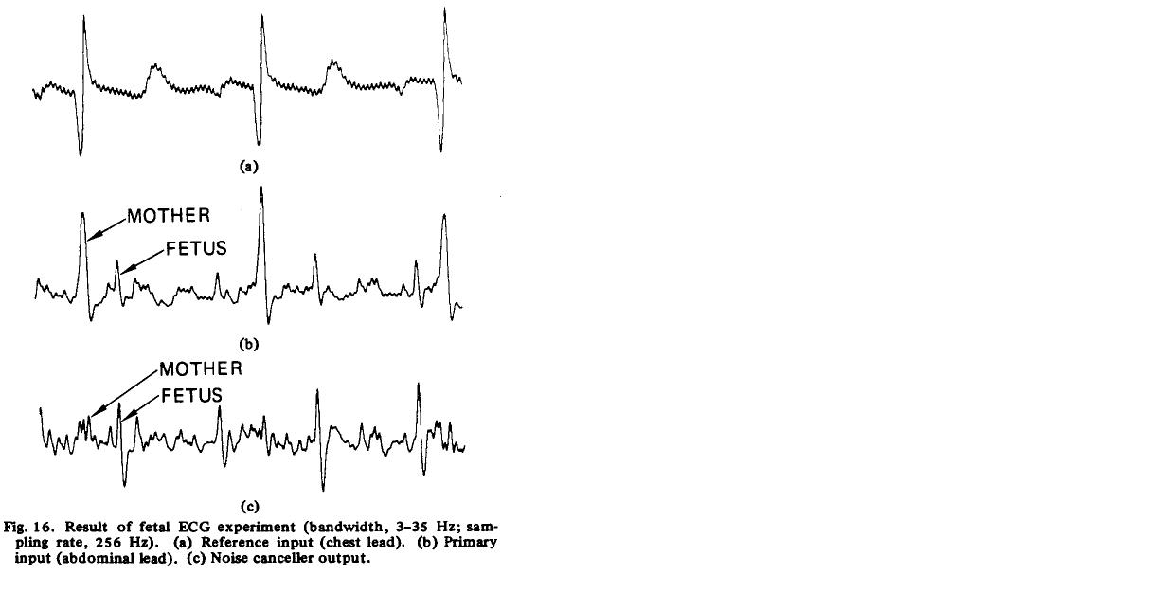

Slide 38
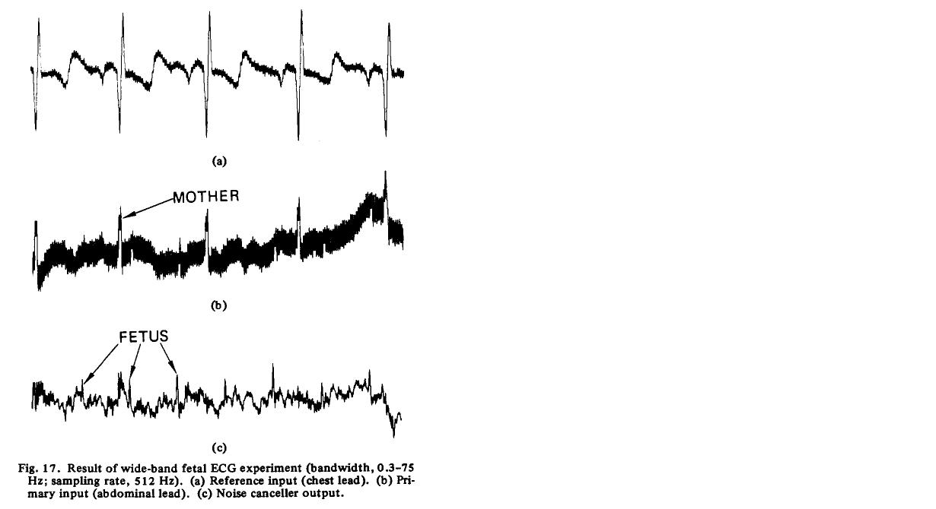

Slide 39
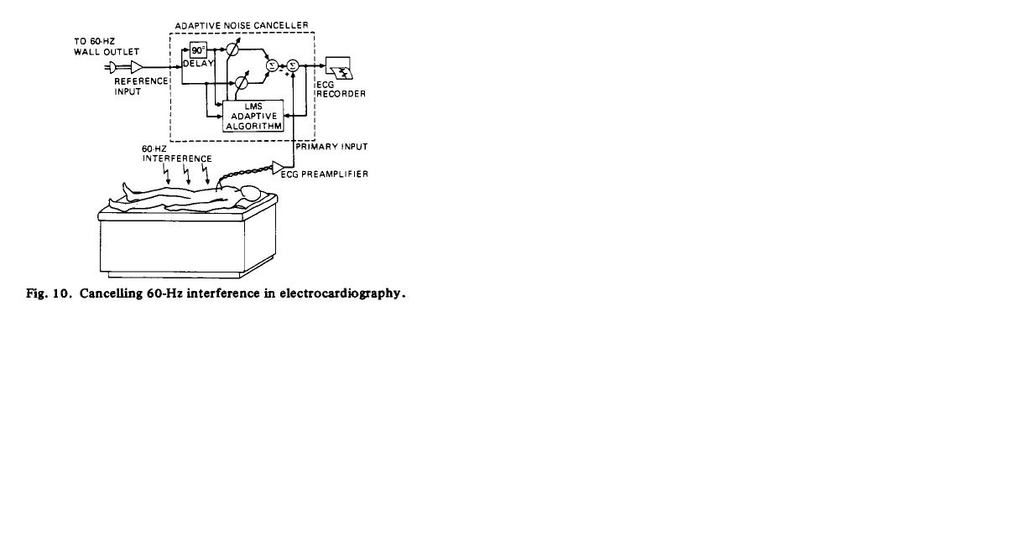

Slide 40
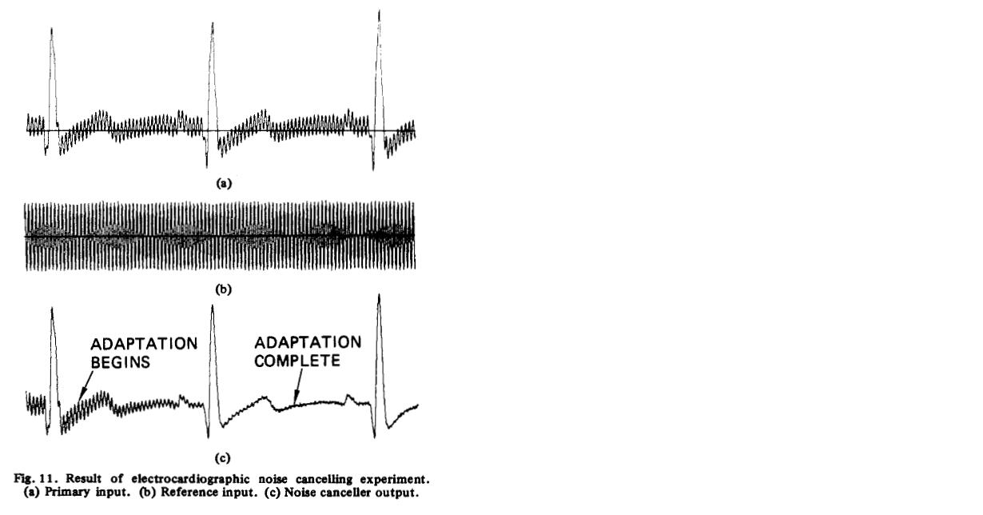

Slide 41
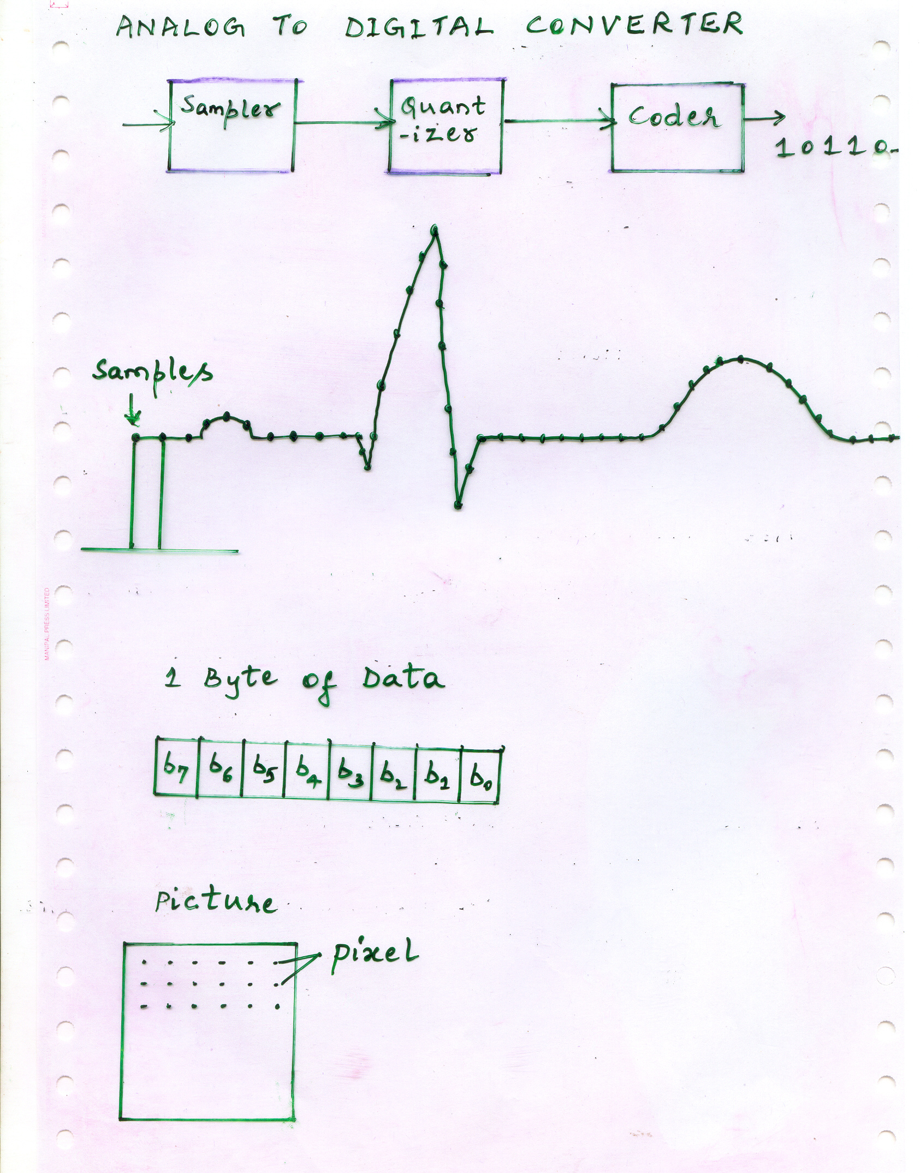

Slide 42
ECG data
C7 | C6 | C5 | C4 | C3 | C2 | C1 | C0
Original pixel
b7 | b6 | b5 | b4 | b3 | b2 | b1 | b0
Watermarked pixel #1
b7 | b6 | b5 | b4 | b3 | b2 | b1 | C0
Watermarked pixel #2
b7 | b6 | b5 | b4 | b3 | b2 | b1 | C1

Slide 43
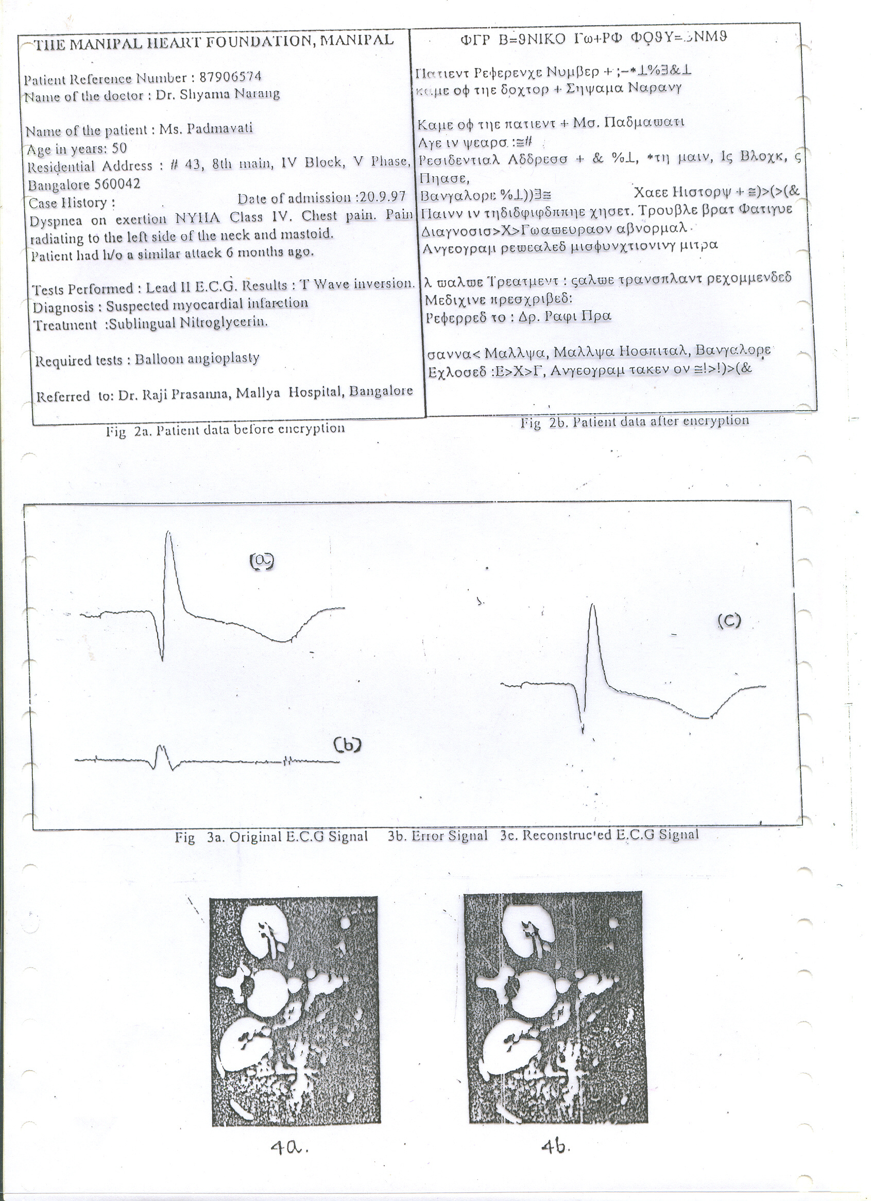

Slide 44
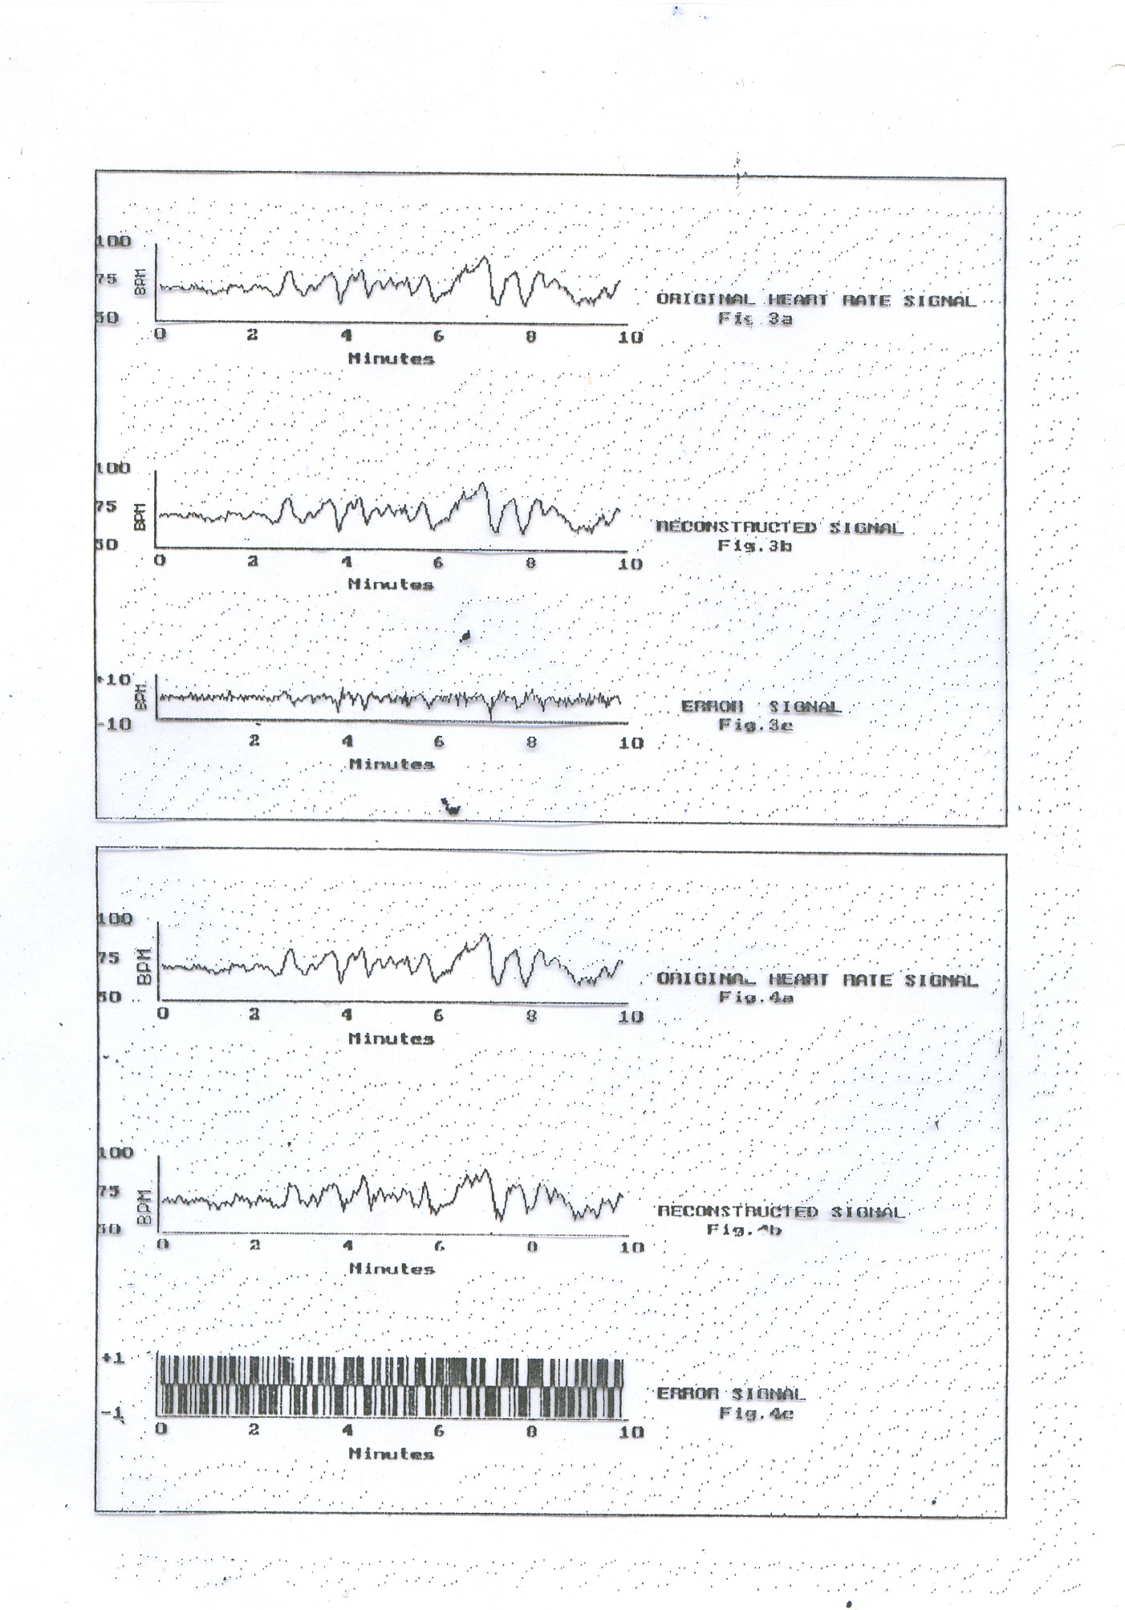

Slide 45
Result of interleaving DPCM error signal in the angiogram image. (a) Original signal. (b) Interleaved signal.

Slide 46
Histogram of ultrasound images. (a) Original image.
(b) Interleaved image.

Slide 47
Applications in Manipal

Slide 48
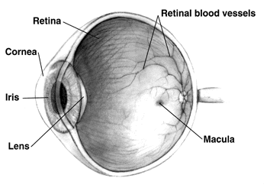
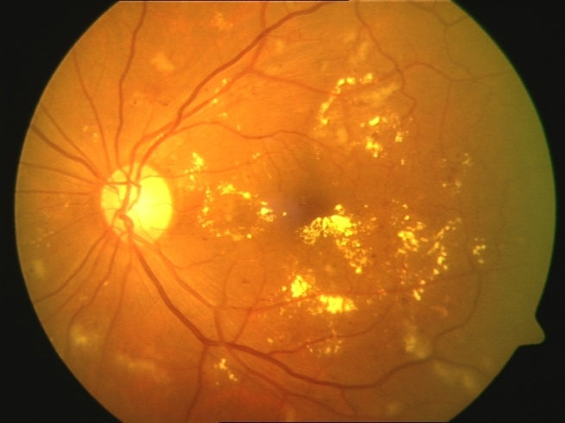
Detction and Grading of Diabetic Retinopathy
Diabetic retinopathy is a retinal vasculature disorder, leading cause of blindness
Hard Exudates
Fig. Presence of Diabetic retinopathy

Slide 49
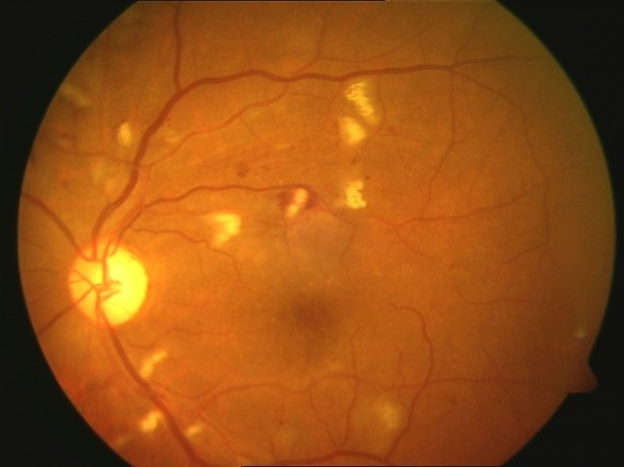
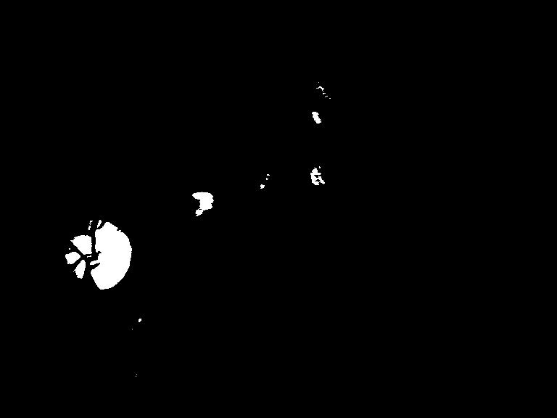
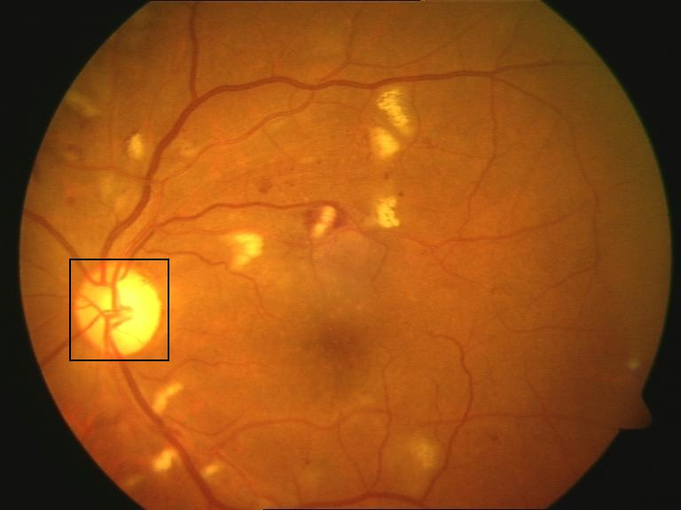
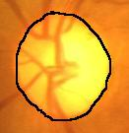
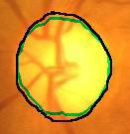

Optic Disc Detection
Input colour retinal image
Thresholded image
Located Optic disc
Hand labeled OD boundary
Overlaid OD boundary
Final detected OD boundary
Department of Computer Science and Engineering, MIT, Manipal

Slide 50




Optic Disc Detection
Digital colour retinal image 19_test.jpg from DRIVE
Manual segmentation of 19_test.jpg retinal image
Segmented vessels from our method
Sensitivity = 88.64% and Specificity = 95.01%
Gabor response image
Department of Computer Science and Engineering, MIT, Manipal

Slide 51

Quantification of Scoliosis
Figure : 1. Scoliotic Radiograph (Courtesy KMC Manipal)

Slide 52


Slide 53




Uterine Cervical Image Analysis
Specuarity reflection removal:
ROI detection:

Slide 54


Data collection…
Images of normal cases
A-before the application of acetic acid, B-after the application of acetic acid
11/01/2023
54
Notes:
<number>

Slide 55

Data collection…
Images of abnormal cases
A-before the application of acetic acid, B-after the application of acetic acid
11/01/2023
55
Notes:
<number>

Slide 56

Breast Thermogram Screening
24 Jan 2022, AICTE-ISTE REFRESHER PROGRAMME
<number>

Slide 57

Segmentation Method
24 Jan 2022, AICTE-ISTE REFRESHER PROGRAMME
<number>

Slide 58

Niramai Solution

Slide 59
Opportunities
5G
Cloud
AI, ML
Semicon
Locapreneurs
Notes:
<number>

Slide 60





Culture
Notes:
<number>

Slide 61



CEOs..
Notes:
<number>

Slide 62

Karmic, Manipal

Slide 63


Slide 64


Slide 65


Slide 66

ISA-2012 Exhibition
Notes:
<number>

Slide 67

<number>

Slide 68

Thank You

Slide 69


ECG

Slide 70


Slide 71

Histogram Distances - HSI

Slide 72

HSI

Slide 73


Intensity Based Retrieval: Results
CDF fitted with p=4
Notes:
<number>

Slide 74

Result #2 - Linear Models of CDF matching

Slide 75

System Architecture
Notes:
<number>

Slide 76
Medical Image Processing Drivers
Semiconductors, Processors
Programmability
Sensors, Transducers
Compute Tools, Cloud
Internet, Data

Slide 77
Ideate
System Design
PoC/Prototype
User forums/kaggle
Opensource/Linux/git

Slide 78
Ideate
Walk the Talk
1 Task @ Time
Brainstorming/write/teach
Different from the crowd

Slide 79
Worldview
NOT Industry Ready
Moonlighting is Right
Marks for Interview
Fundas & skills
Gig-economy = GenZ
Notes:
<number>

Slide 80
Worldview
MNCs Hire & Fire
HighEducation Unworthy
Gender/Region Parity
Great Resignation
Future is Dark/Bright
Notes:
<number>

Slide 81
Pseudo Code
face_cascade = cv2.CascadeClassifier('haarcascade_frontalface_default.xml')
img = cv2.imread('sachin.jpg')
gray = cv2.cvtColor(img, cv2.COLOR_BGR2GRAY)
faces = face_cascade.detectMultiScale(gray, 1.3, 5)
for (x,y,w,h) in faces:
cv2.rectangle(img,(x,y),(x+w,y+h),(255,0,0),2)
cv2.imshow('img',img)
cv2.waitKey(0)
cv2.destroyAllWindows()
Notes:
<number>
<number>

Slide 82

Multi-task Cascaded Convolutional Network

